Slide 1


No Place for Bullying in Our Circle of Grace
1
© Archdiocese of Omaha 2026

Slide 2
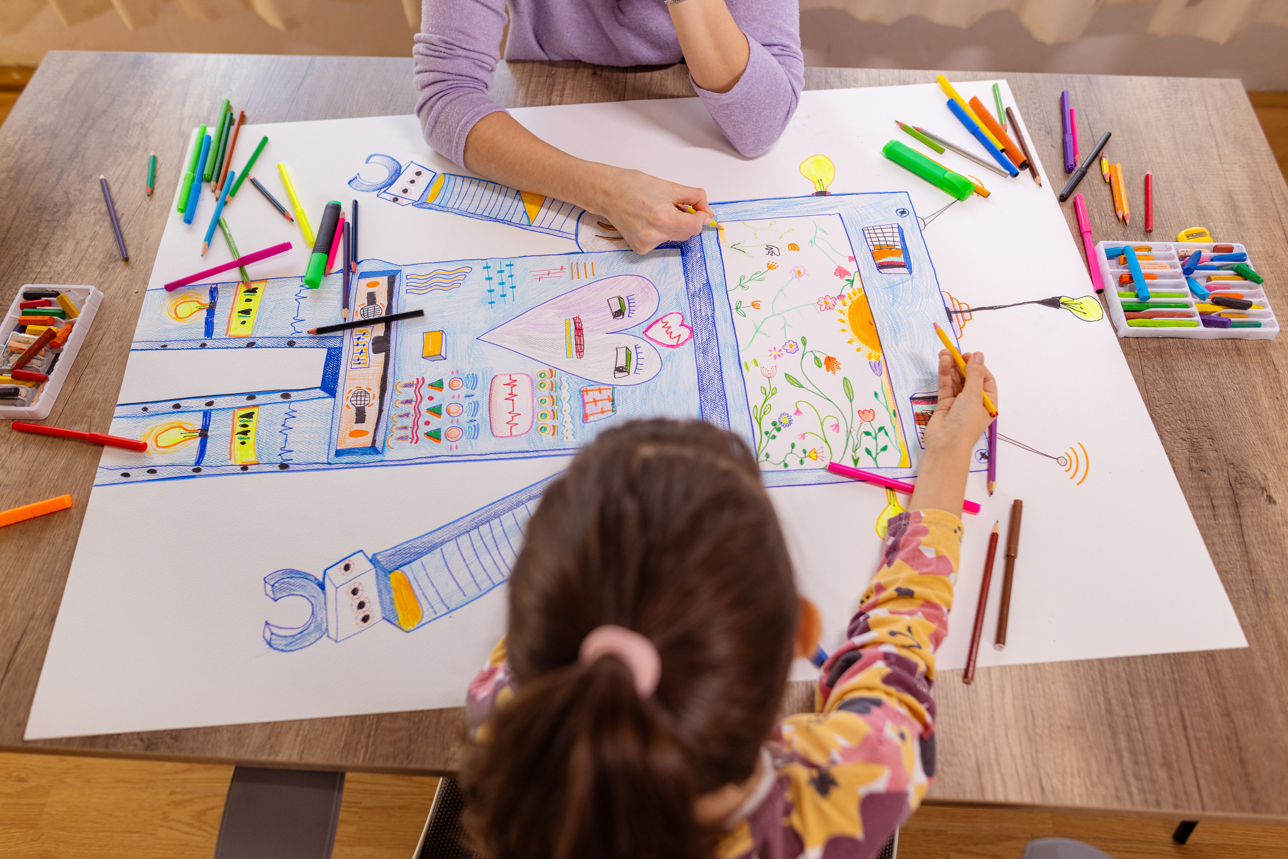
Introduction
The Circle of Grace Team has a poster contest for our diocese in April, Child Abuse Prevention Month.
Many of the posters, particularly younger grades, were about bullying not belonging in their Circle of Grace.
2
© Archdiocese of Omaha 2026
Notes:
Bullet #1: We sent a template to our partner dioceses encouraging them to have a poster contest in their diocese. Several shared their posters with us. The posters were awesome, creative, and heartbreaking.
Bullet #2: You could see the pain in the drawings. The team believed the youth were sending a clear message for help keeping bullying out of their Circle of Grace. This training is our response to the youth's courage to expose the world they have to navigate.

Slide 3
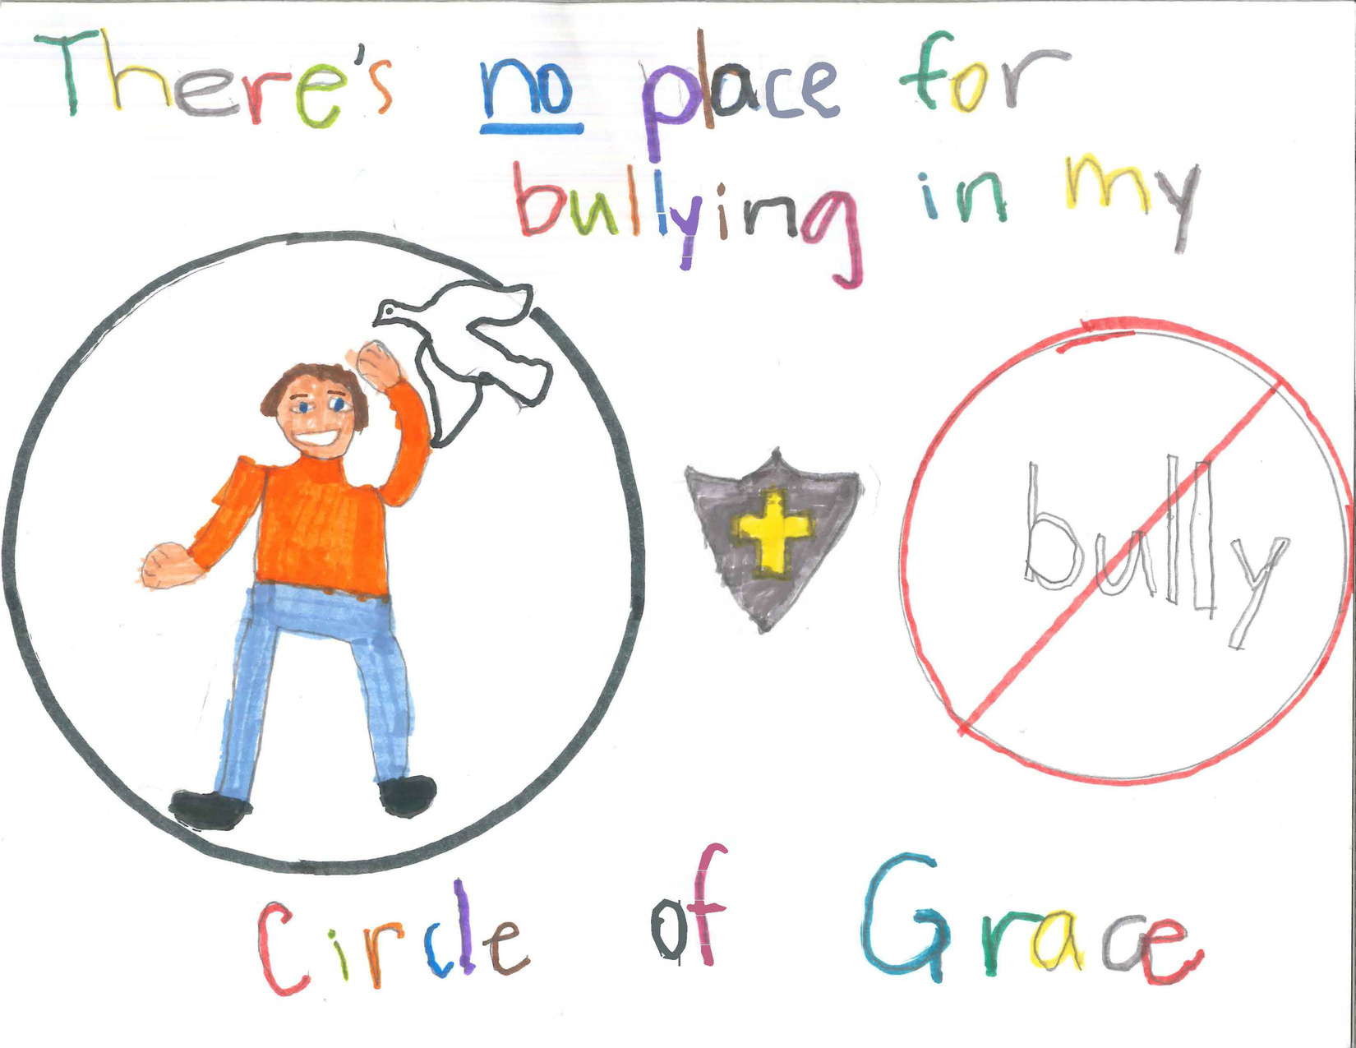
Circle of Grace 2025 Poster Submissions
3
4ᵗʰ grade student
© Archdiocese of Omaha 2026

Slide 4
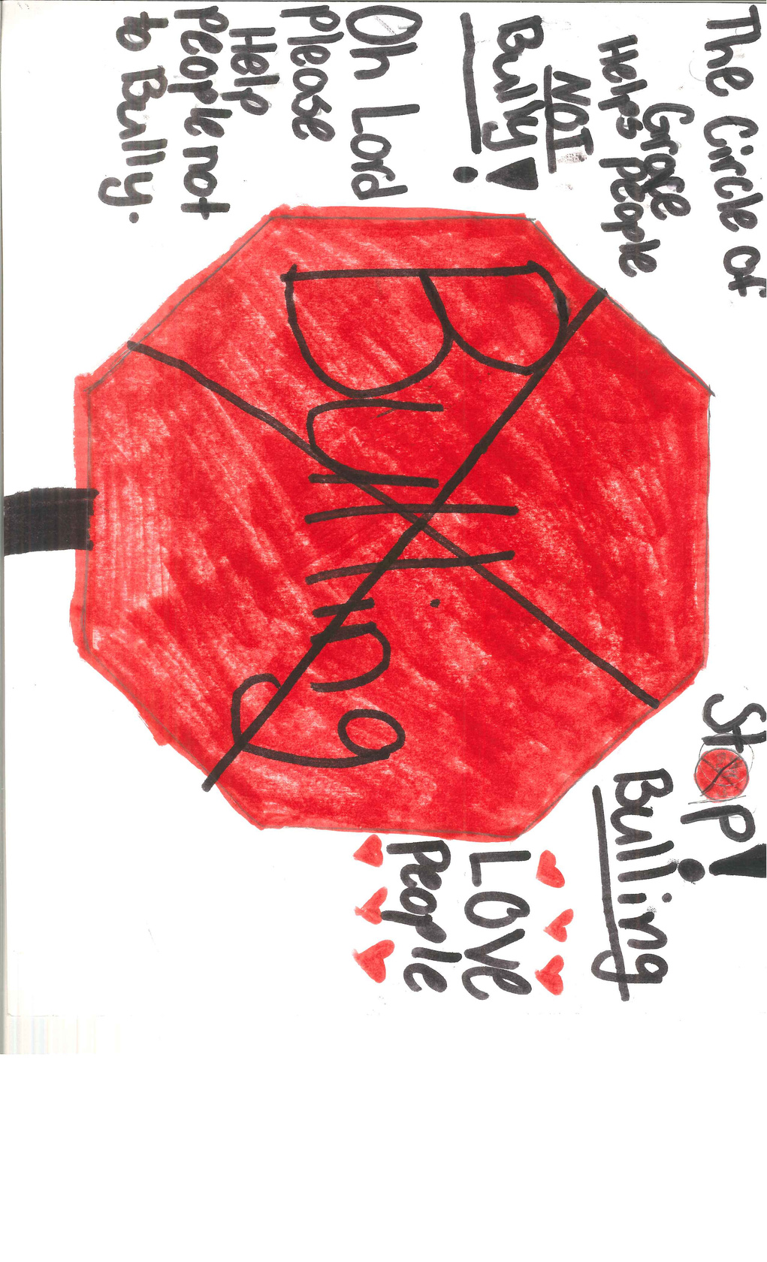
“Oh Lord, please help people not to bully.”
4ᵗʰ GRADE STUDENT
4
© Archdiocese of Omaha 2026

Slide 5
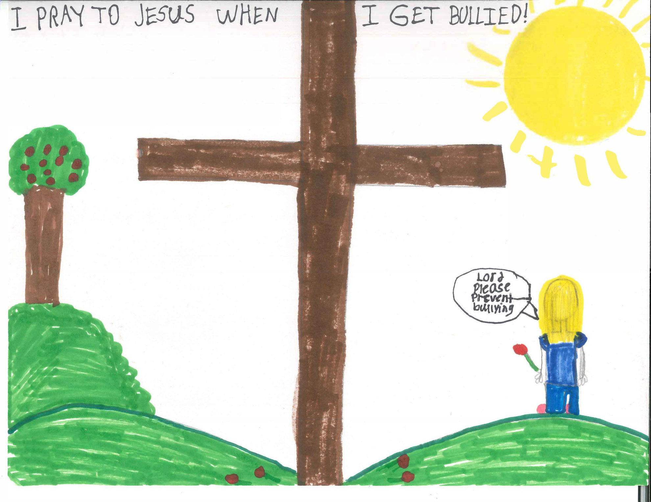
“Lord, please prevent bullying.”
2ⁿᵈ grade student
5
© Archdiocese of Omaha 2026

Slide 6

Personal Reflection
Was there a time where you or someone you know was bullied?
How severe was it?
How did it affect you then?
How does it affect you today?
What lies did you believe about yourself?
Was there anyone who was there for you?
Did it affect your relationship with God?
6
© Archdiocese of Omaha 2026
Notes:
Take a moment and reflect on when you were young.…..
Take time to personally journal about these reflection questions.

Slide 7

Today bullying is more extensive because of social media!
Good news is that we can be the trusted adult that may not have been there for us!
7
© Archdiocese of Omaha 2026

Slide 8

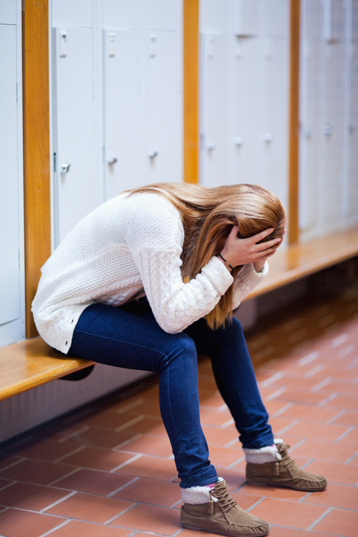
“ The second time I reported being bullied to an adult at school, I was told I wasn’t being bullied because I “didn’t fit” the mold of someone being bullied. Why would the popular athlete be bullied? They’re just your friends poking fun, and you’re being too sensitive.”
NCAA Athlete, age 21
8
© Archdiocese of Omaha 2026
Notes:
Discussion Questions:
How would you respond to this child?
What needs to be done?
What are the obstacles for this trusted adult?

Slide 9

“I thought that there would be less bullying at middle school because there are so many people there, but it’s just made it worse. The words the kids say are so much crueler, and they bully you even if they don’t know you. I won’t go to the bathroom all day long when I’m at school, because I am scared of what would happen if I did go in. I’ve seen what’s happened to other kids. I feel pretty hopeless, because I’ve told a couple of teachers, and they won’t do anything about it. I think they are scared of the bullies, too.”
6th-grade student, age 12
9
© Archdiocese of Omaha 2026
Notes:
Discussion Questions:
How would you respond to this child?
What needs to be done?
What are the obstacles for this trusted adult?

Slide 10

Bullying Statistics
One out of every 5 students report being bullied.
The most common forms of bullying were spreading rumors (13.0%) and being made fun of or called names (11.9%).
100% of student participants reported experiencing, witnessing, or being aware of acts of bullying during the 2021-2022 school year.
Across the United States, 44.2% of students reported notifying a trusted adult about bullying.
Students ages 12 – 18 who reported being bullied during school, 21.6% were bullied online or by text.
10
© Archdiocese of Omaha 2026
Notes:
References:
National Center for Education, 2021
National Center for Education Statistics, 2022
National Center for Education Statistics, 2022
National Center for Education Statistics, 2022
National Center for Education Statistics, 2024

Slide 11
Bullying Statistics continued…
The percentages of students ages 13 – 17 who have experienced cyberbullying at some point in their lifetimes have more than doubled (18.8% to 54.6%) from 2007-2023.
Specific types of cyberbullying students had experienced in the previous 30 days:
mean or hurtful comments posted online (30.4%)
exclusion from group chats (28.9%)
rumors spread online (28.4%)
someone embarrassing or humiliating them online (26.9%) were the most reported.
The percentages of schools that reported cyberbullying occurrences at least once a week were highest among middle schools (37%), followed by high schools (25%), and then elementary schools (6%).
11
© Archdiocese of Omaha 2026
Notes:
References:
Patchin & Hinduja, 2024
Patchin & Hinduja, 2024
National Center for Education Statistics, 2024
What of these statistics was most surprising to you?

Slide 12
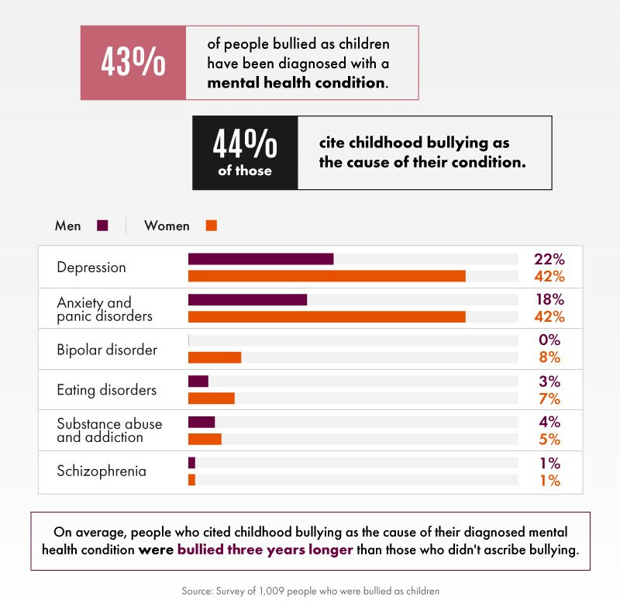
Long Term Effects of Bullying
© Archdiocese of Omaha 2026
12
Notes:
This graph is a glimpse of the psychological long-term effects of bullying. Are there long-term physical health consequences of bullying? Social or economic impacts? Long-term behavioral effects?

Slide 13

“When youth are excluded from social activities by their peers at school, the outcomes for that student, both short-term and long-term will be just as detrimental as if they got kicked, punched, or slapped every day.”
(Survey of Secondary Youth on Relational Aggression: Impact of Bullying, Social Status, and Attitudes, 2022)
13
© Archdiocese of Omaha 2026
Notes:
Think about the kids you work with... Can you think of a kid that this statement may apply to?

Slide 14

“I have forgiven the kids who were cruel to me and the ones who were too afraid to speak up, but I struggle to understand why teachers and parents, who witnessed the abuse I endured, to turn their backs to the situation. I was visibly drowning in despair and the ones I was told to trust, did nothing. ”
Licensed Mental Health Therapist, age 35
14
© Archdiocese of Omaha 2026
Notes:
Discussion Questions:
How would you respond to this child?
What needs to be done?
What are the obstacles for this trusted adult?

Slide 15

Did you know…
15
© Archdiocese of Omaha 2026

Slide 16

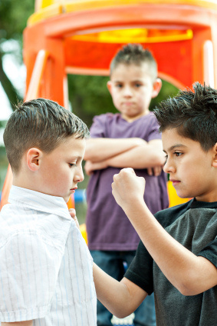
Understanding the person who bullies
Bullying is a learned behavior
They may have abusive or overly strict parents
No structure or discipline at home
Adults (parents or others) can model bullying and aggressive behavior
They crave attention, even if it is negative
May have low self esteem and/or feel insecure
They want to be popular and/or have a sense of entitlement
16
© Archdiocese of Omaha 2026
Notes:
Parents are charged with helping children understand that everyone has dignity.
It is important that we pray for the child who bullies as they are likely struggling with their own issues.

Slide 17



Bullying Behaviors
Fighting vs. Bullying
Have an imbalance of power by:
Fighting is an equal power conflict
Bullying occurs between a powerful aggressor and a target who lacks the power to fight back
Using their strength, age, size, and status
Accessing and spreading embarrassing information in person and online
Seeking popularity by overpowering others
17
© Archdiocese of Omaha 2026
Notes:
People tend to use the word “bullying” too freely.
Fighting, rude or selfish behaviors such as a child wanting to sit with someone else at lunch is not bullying.
A child who is not receiving as much playing time on the basketball court compared to another child, is not being bullied by a coach.

Slide 18

Bullying is intentional AND repeated acts that make the targeted
person upset or uncomfortable.
Bullying is calculated and ongoing abuse.
18
© Archdiocese of Omaha 2026
Notes:
When a child comes to you to report bullying, listen and believe them.

Slide 19

Gateway Bullying Behaviors
Whispering about others in front of them
Laughing at others openly
Eye rolling
Ignoring
Name calling
Encouraging peers to end friendships
Unfriending/unfollowing from social media
19
© Archdiocese of Omaha 2026
Notes:
These behaviors do not necessarily indicate bullying, however, can be the beginning stages of asserting dominance or expressing contempt.
These precursor behaviors, when repeated, can be indicative of bullying.
Adults should respond to gateway behaviors to reiterate the importance of treating others with respect and that we are all God’s children.

Slide 20

What are other examples of gateway bullying behaviors?
What are appropriate responses/consequences to address these behaviors?
How does free will play into bullying?
How would you respond to a child who bullies people and thinks God no longer loves them?
20
© Archdiocese of Omaha 2026

Slide 21
In Person vs. Online Bullying
In Person
Online
Opportunity to be witnessed and see the reaction of the person targeted
Is usually at school or events
Sometimes there are visible injuries
Adults are more likely to intervene when the bullying is in person
Online can be worse because it is 24/7 in today’s culture
No one witnesses how the cruel statements affect the person targeted
The injuries are not visible
Although online bullying can happen during school hours it is more prevalent after hours
21
© Archdiocese of Omaha 2026
Notes:
In Person
Bullet #1: This gives others a chance to intervene with compassion.
Bullet #2: but bullying continues on social media so there is no reprieve.
Bullet #3: This is usually when the adults become involved.
Online bullying or Cyberbullying is the use of technology to harass, threaten, embarrass, or target another person trough text, apps, social media, forums, or gaming platforms.
Bullet #1: The targeted person can’t get away.
Bullet #3: but are more dangerous because no one can see how the targeted person is hurting.
Bullet #4: so there can be a lack of accountability

Slide 22

Key Elements Needed to Bully
Cooperation and Access
The person being targeted, and others, may passively cooperate with the bullying behavior and requests, out of fear.
Environments that tolerate bullying behavior, both in person and online, gives power to those who torment others.
22
© Archdiocese of Omaha 2026
Notes:
Bullet #1: By doing this, they hand over their power to the person who bullies.

Slide 23
Key Elements Needed to Bully
Adult Relationships
Students Response
No partnership between parents and the professionals in the schools and parishes
Both believe the other should deal with the behaviors especially when the bullying is online
No unified front to combat the behavior
Bystanders feel helpless and fear retaliation if they intervene or report the behavior
Try to please the person bullying so they won't be targeted by chiming in with the behavior, especially online.
No safe way for someone to share their concerns without being exposed
23
© Archdiocese of Omaha 2026

Slide 24
Parents
of youth involved
Bullying Continues if….
Bystanders
Youth
involved
School
24
© Archdiocese of Omaha 2026
Notes:
Key people are not aware, in agreement and support stopping it
Keep bullying conversations between adults so kids cannot overhear.
Support needs to include follow through at home and instruction on how to treat others.
Remember the Golden Rule: Treat others how YOU want to be treated!!
Group Discussion Questions:
How hard would this be to get everyone involved?
What would be the obstacles?
What steps as a school/parish can you take if the parents don’t cooperate?

Slide 25
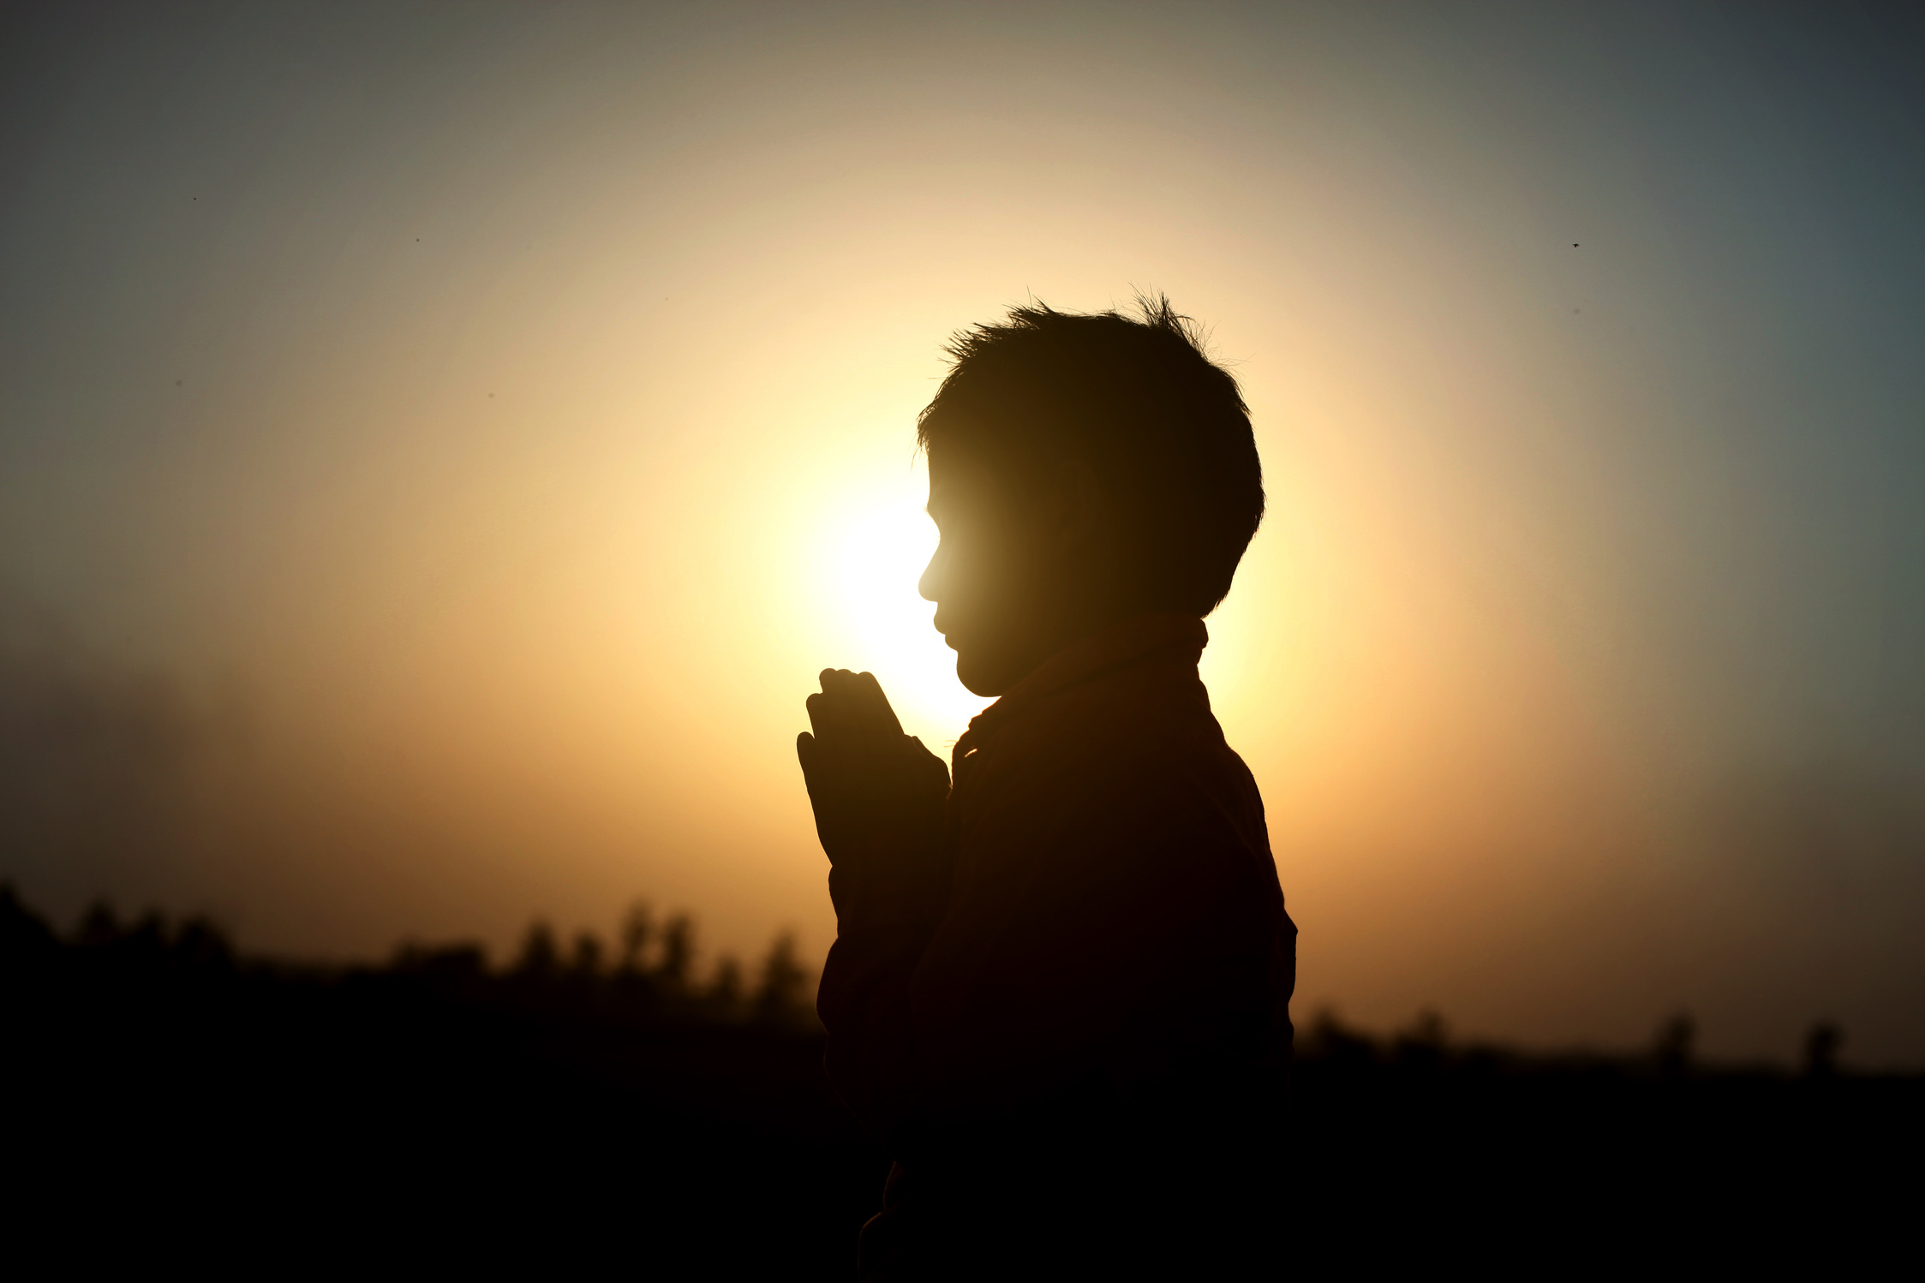
How Circle of Grace Can Stamp out Bullying
Key points that need to be taught from the heart
Relationship with God
Truly believing that God desires a relationship with us.
Realize ones true identify is being His child.
Understanding the Holy Spirit helps us discern difficult and unsafe situations
One is less likely to bully if one believes that God is in everyone’s Circle of Grace, and that we all belong to Him
25
© Archdiocese of Omaha 2026
Notes:
Remember that all kids are different and we should celebrate the uniqueness of each one of God’s children.

Slide 26
How Circle of Grace Can Stamp out Bullying
Key points that need to be taught from the heart
Relationship with Self & Others
Understanding that one is sacred in God’s eyes counters the lies that come from being bullied.
Knowing everyone is sacred in God’s eyes deters bullying and motivates others to report it when they are aware someone is being targeted.
Understanding God’s grace is so close that it helps us with discerning difficult situations.
We have a loving God. Our connection with Him should reflect our actions.
26
© Archdiocese of Omaha 2026

Slide 27
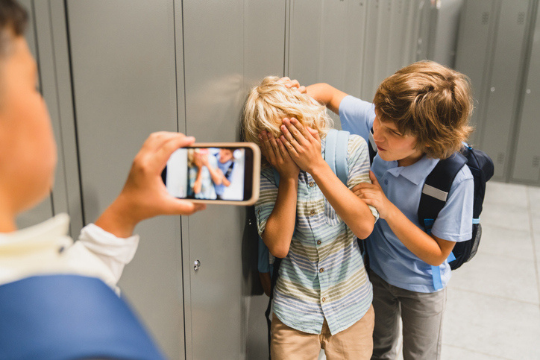
Take a Stand: Stamp out Bullying
Steps for Parishes and Schools
27
© Archdiocese of Omaha 2026

Slide 28

Establish a Zero Tolerance for Bullying
Set expectations of appropriate behavior
Clear definition of bullying
Clear consequences
Clear path to report
Make a contract not to bully
Put all the above in the parent-student handbook
28
© Archdiocese of Omaha 2026
Notes:
Bullet 1: have detailed explanations of expectations
Bullet 2: in person and online
Bullet 3: for one who bullies the consequences reflect the seriousness
Bullet 4: Provide an option to report anonymously
Bullet 5: That includes signatures from key people and review several times a year

Slide 29

Involve the Students in the Solution
29
© Archdiocese of Omaha 2026

Slide 30
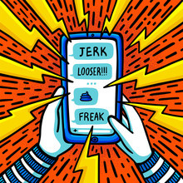
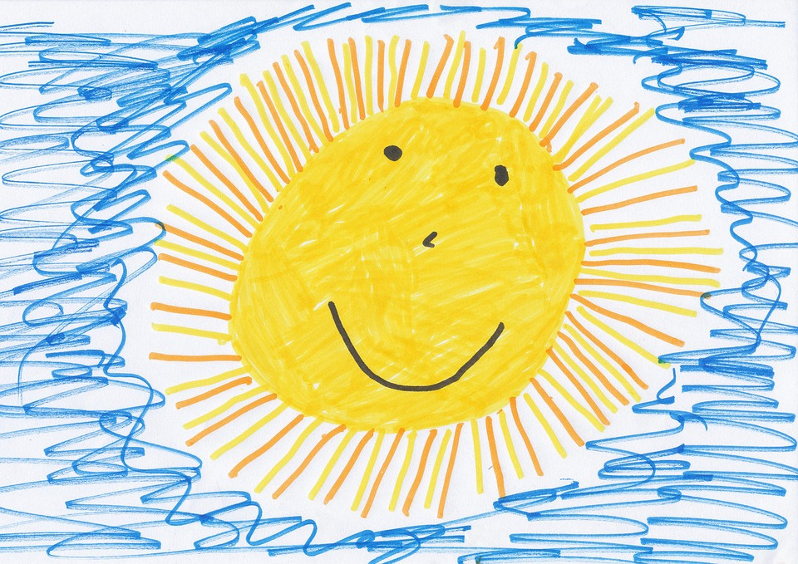
When Words Don’t Work, Art Does…
Sometimes nothing speaks
more powerful than art.
Have the students (K-12) draw a symbol of:
how it FEELS to be bullied
how they would FEEL if they never had to worry about being bullied
30
© Archdiocese of Omaha 2026

Slide 31
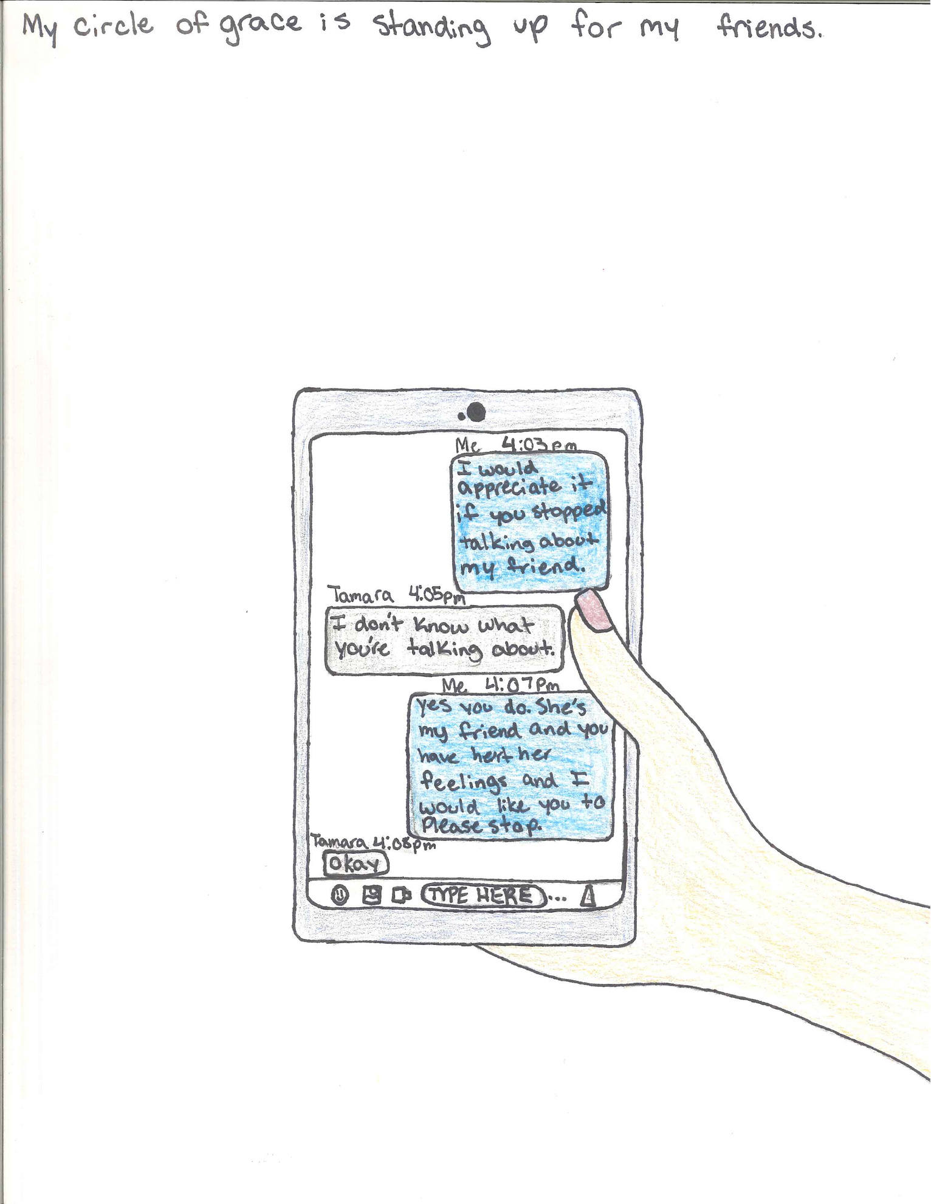
“My Circle of Grace is standing up for my friends”
7th grade student
31
© Archdiocese of Omaha 2026

Slide 32

Do a Grade 1- 4 Student Assessment
Have them identify the Circle of Grace feeling faces, or draw their own to the below sample prompts:
How do you feel when someone is being mean to you?
Who is being mean to you?
Where is this happening?
What adult listens to your hurt?
What adult makes you feel safe?
32
© Archdiocese of Omaha 2026

Slide 33

Develop a Grade 5-12 Student Survey
Sample Questions:
How would you define online and in person bullying?
Have you ever been bullied?
Where were you bullied?
When were you bullied?
Who bullied you?
Why do you think you were bullied?
Have you witnessed others being bullied?
What did you do?
33
© Archdiocese of Omaha 2026
Notes:
Bullet #3: did you do nothing, join in, or speak up?

Slide 34
Grade 5-12 Student Survey Continued
4. Rate the problem of bullying in your
school/parish from 1 to 10.
5. Were you ever a bully?
Why did you bully?
6. What ideas do you have to stamp out
bullying?
7. Who could you talk to about bullying?
34
© Archdiocese of Omaha 2026
Notes:
Bullet #4: 1 being not a problem; 10 being a major problem
Circle of Grace Code of Conduct (found in the 7th grade section and in admin section) is a great resource.

Slide 35

Students Input on How to Stamp out Bullying
Distribute and evaluate both the assessments and surveys
Present survey results and art symbols to the student body
Convene a committee that includes students and parents to study the survey/assessment results and art symbols then develop solutions
Bring the solutions back to the student body
35
© Archdiocese of Omaha 2026
Notes:
Bullet #1: Give them the option to be anonymous
Bullet #4: It could be as easy as a “Being Nice”
Large group discussion:
How do we ensure the committee has the power and the tools they need to make change?

Slide 36



CIRCLE OF GRACE
Raise your hands above your head, then slowly lower your arms.
Extend your arms forward and backward, embracing the space around you.
Finally, reach down toward your feet, remembering that God is present in this space.
This is your Circle of Grace—and you are within it.
36
© Archdiocese of Omaha 2026
Notes:
By reinforcing our Circle of Grace daily, we know God is always present. He helps us know what belongs and what does not belong in our Circle of Grace. He helps us know when to ask for help from someone we trust.
There is a Parents First special Edition on Bullying as a resource pertaining to free will and human dignity.

Slide 37

Key Takeaways
Arguments are natural and an essential part of developing strong conflict resolution skills. However, bullying is never acceptable.
Utilize Circle of Grace teachings and language.
When you see something, say something!
Bullying: zero-tolerance policy
37
© Archdiocese of Omaha 2026
Notes:
Bullet #1: It is okay for children to have disagreements, and it is unavoidable. We, as trusted adults, must model respect and dignity when presented with adversity. We must also be vigilant in looking for gateway behaviors to avoid bullying all together.
Bullet #2: Many victims of bullying often feel isolated and helpless and in turn, may not ask for help. As a trusted adult, it is our responsibility to safeguard our children, and sometimes, that means redirecting and practicing fortitude in tough situations.
Bullet #3: Circle of Grace provides the guidance on how to maintain a relationship with God, self, and others.
Bullet #4: make this interactive and welcome student feedback
Forgiveness and restored relationships with others is the desired outcome for all those involved in a bullying.

Slide 38
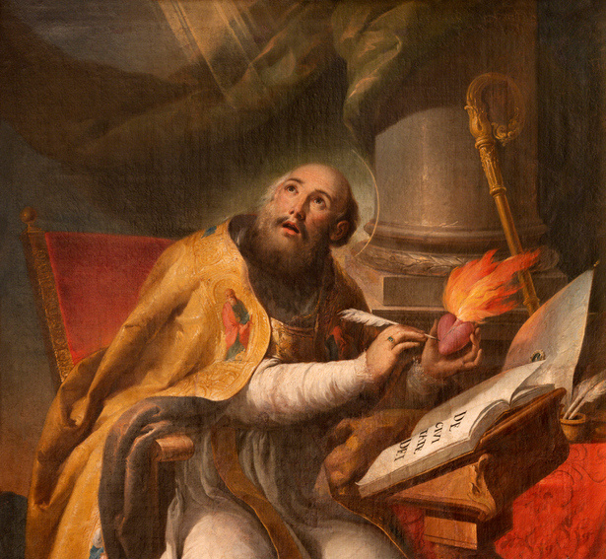
“Wrong is wrong even if everyone is doing it.
Right is right even if no one is doing it.”
– St. Augustine
38
© Archdiocese of Omaha 2026

